Slide 1
Chapter 25 Electric Potential

Slide 2
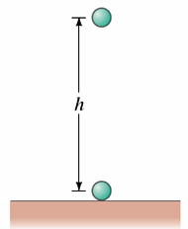
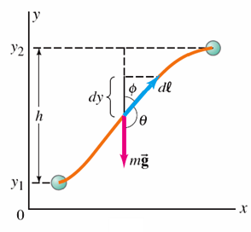
Brief Review of Some Physics Concepts
Definition
A force is conservative if & only if
the work done by that force on an object moving from one point to another depends ONLY on the initial & final positions of the object, & is independent of the particular path taken.
Example: Gravity
Notes:
Figure 8-1. Caption: Object of mass m: (a) falls a height h vertically; (b) is raised along an arbitrary two-dimensional path.

Slide 3
Conservative Force: Another definition:
A force is conservative if the net work done by the force on an object moving around any closed path is zero.
Notes:
Figure 8-2. Caption: (a) A tiny object moves between points 1 and 2 via two different paths, A and B. (b) The object makes a round trip, via path A from point 1 to point 2 and via path B back to point 1.

Slide 4
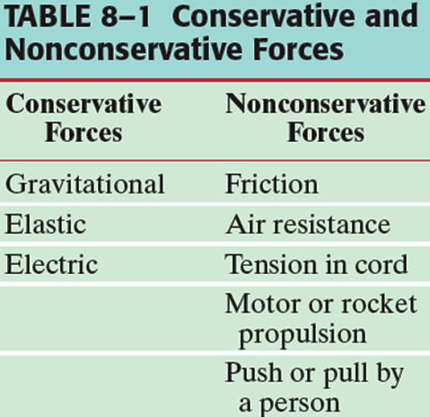
Potential Energy:
Can only be defined for
Conservative
Forces!
The change in the Potential Energy is defined to be the negative of the work done by the conservative force.
End of Brief Review!!

Slide 5
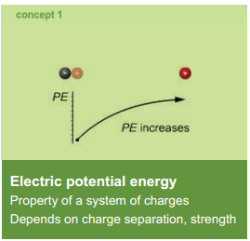
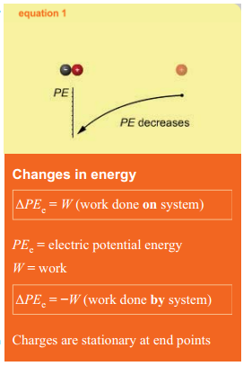
Electric Potential Energy

Slide 6
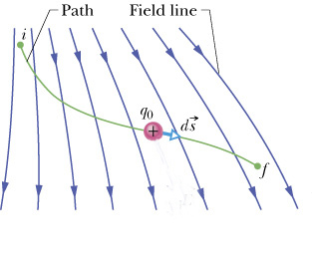
Electrical Potential Energy
When a test charge is placed in an electric field, it experiences a force.
The force is conservative.
If the test charge is moved in the field by some external agent, the work done by the field is the negative of the work done by the external agent.
is an infinitesimal displacement vector that is oriented tangent to a path through space.
The path may be straight or curved and the integral performed along this path is called either a path integral or a line integral.
Section 25.1

Slide 7
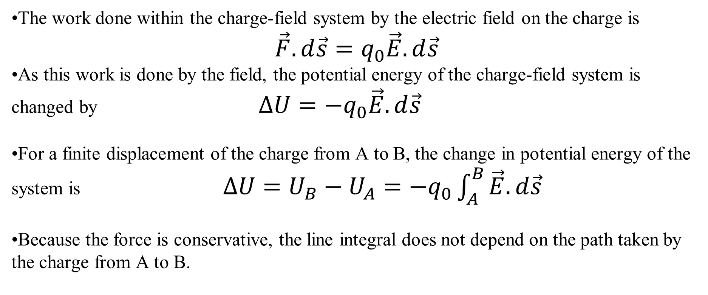
Electric Potential Energy, cont.
The work done within the charge-field system by the electric field on the charge is
$$\vec{F}.d\vec{s}=q_{0}\vec{E}.d\vec{s}$$
As this work is done by the field, the potential energy of the charge-field system is changed by $∆U=−q_{0}\vec{E}.d\vec{s}$
For a finite displacement of the charge from A to B, the change in potential energy of the system is $∆U=U_{B}−U_{A}=−q_{0}\int_{A}^{B}{\vec{E}.d\vec{s}}$
Because the force is conservative, the line integral does not depend on the path taken by the charge from A to B.
Section 25.1

Slide 8
Electric Potential
The potential energy per unit charge, U/q_{o}, is the electric potential
Both electrical potential energy and potential are scalar quantities
The potential is characteristic of the field only (independent of the value of q_{o}) and has a value at every point in an electric field
As a charged particle moves in an electric field, it will experience a change in potential
The infinitesimal displacement is interpreted as the displacement between two points in space rather than the displacement of a point charge.

Slide 9
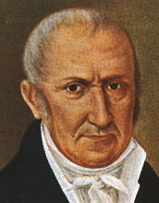
Electric Potential
We often take the value of the potential to be zero at some convenient point in the field,
SI unit of potential difference is Volt (V): 1 V = 1 J/C
The electron volt (eV) is defined as the energy that an electron gains when accelerated through a potential difference of 1 V: 1 eV = 1.6 x 10⁻¹⁹ J
Alessandro Giuseppe
Antonio Anastasio
Volta
1745-1827

Slide 10
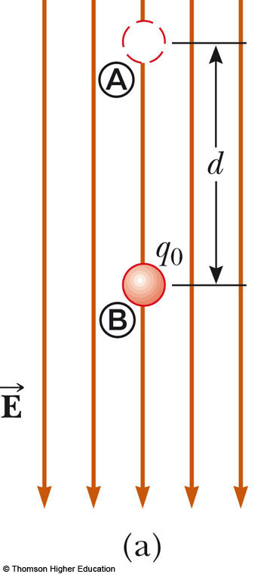
Potential Difference in a Uniform Field
The equations for electric potential can be simplified if the electric field is uniform:
The negative sign indicates that the electric potential at point B is lower than at point A
Electric field lines always point in the direction of decreasing electric potential

Slide 11
Energy and the Direction of Electric Field
When the electric field is directed downward, point B is at a lower potential than point A
When a positive test charge moves from A to B, the charge-field system loses potential energy
The system loses electric potential energy when the charge moves in the direction of the field (an electric field does work on a positive charge) and the charge gains kinetic energy equal to the potential energy lost by the charge-field system

Slide 12
Energy and the Direction of Electric Field
If q_{o} is negative, then ΔU is positive
A system consisting of a negative charge and an electric field gains potential energy when the charge moves in the direction of the field
In order for a negative charge to move in the direction of the field, an external agent must do positive work on the charge

Slide 13
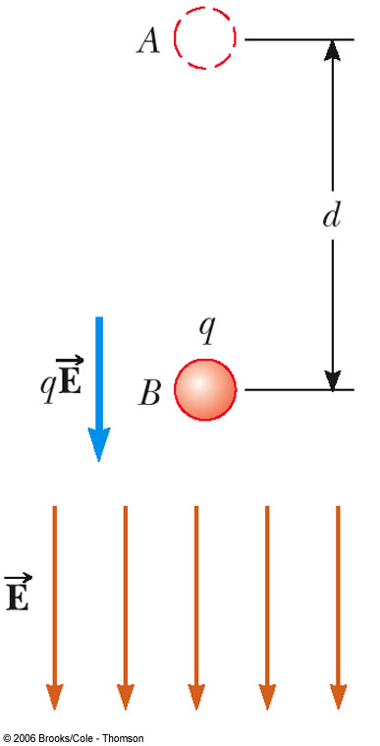
Energy and Charge Movements
A positive (negative) charge gains (loses) electrical potential energy when it is moves in the direction opposite the electric field
If a charge is released in the electric field, it experiences a force and accelerates, gaining kinetic energy and losing an equal amount of electrical potential energy
When the electric field is directed downward, point B is at a lower potential than point A: a positive test charge moving from A to B loses electrical potential energy

Slide 14
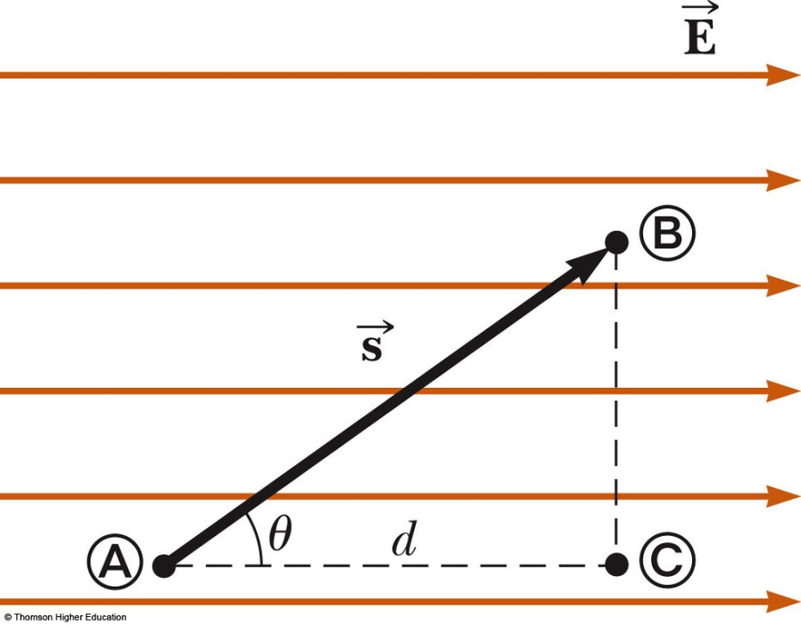
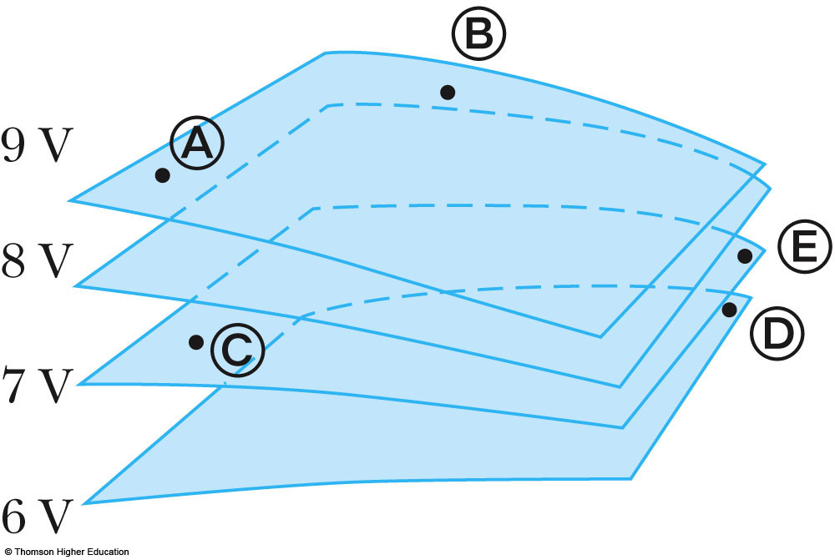
Equipotentials
Point B is at a lower potential than point A
Points B and C are at the same potential, since all points in a plane perpendicular to a uniform electric field are at the same electric potential
Equipotential surface is a continuous distribution of points having the same electric potential

Slide 15
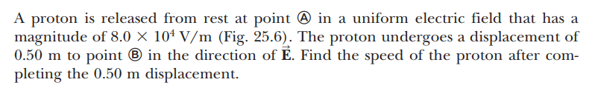
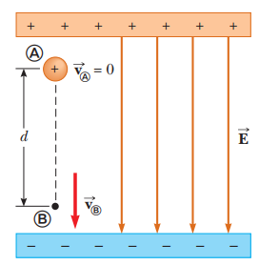


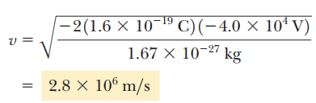

Problem

Slide 16
Problem
An electric field is given by E = E₀ j^, where E₀ is a constant. Find the potential as a function of position, taking V = 0 at y = 0.

Slide 17
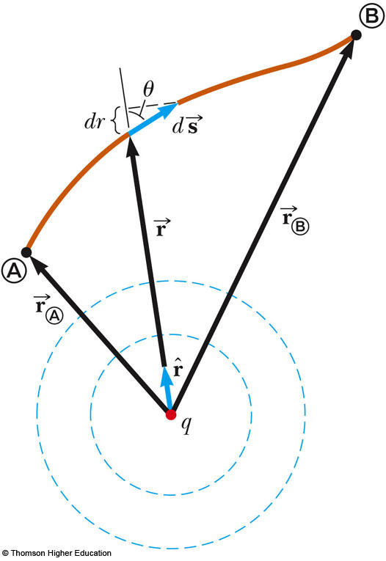
Potential of a Point Charge
A positive point charge produces a field directed radially outward
The potential difference between points A and B will be:

Slide 18
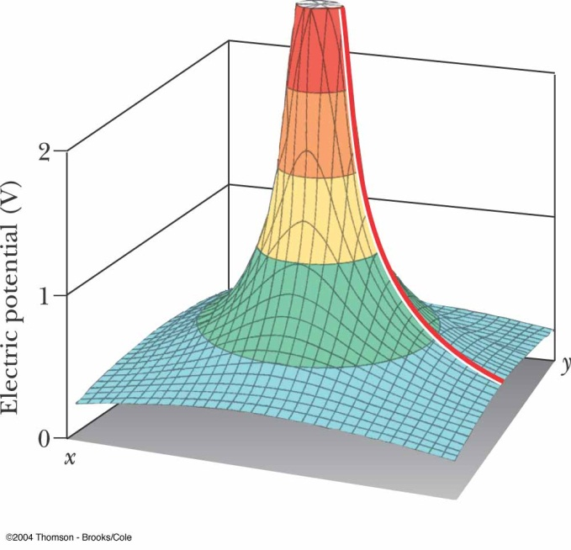
Potential of a Point Charge
The electric potential is independent of the path between points A and B
It is customary to choose a reference potential of V = 0 at r_{A} = ∞
Then the potential at some point r is:

Slide 19
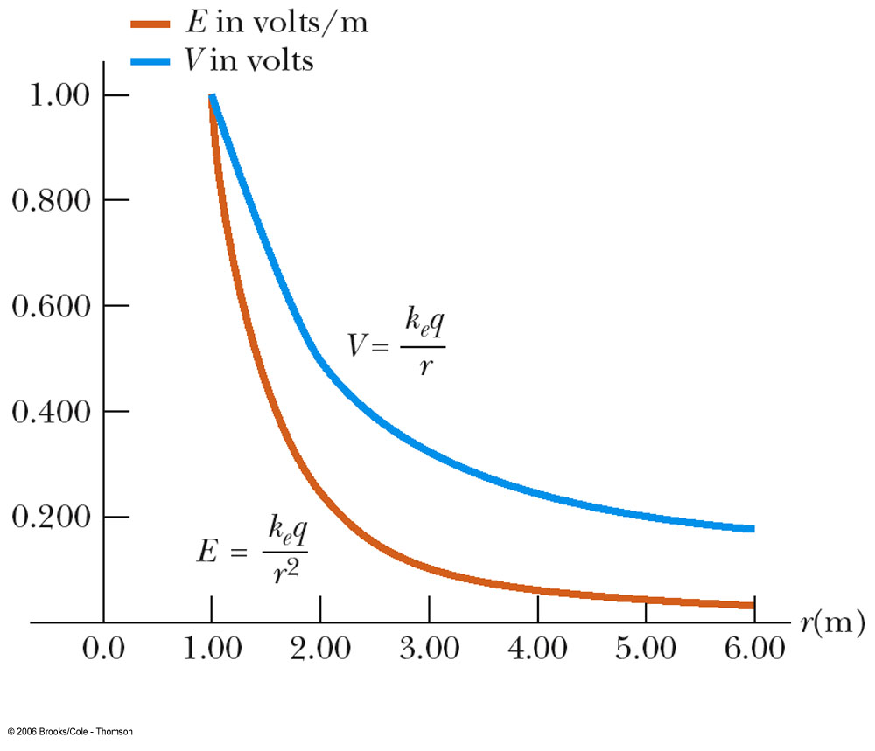
Potential of a Point Charge
A potential exists at some point in space whether or not there is a test charge at that point
The electric potential is proportional to 1/r while the electric field is proportional to 1/r²

Slide 20
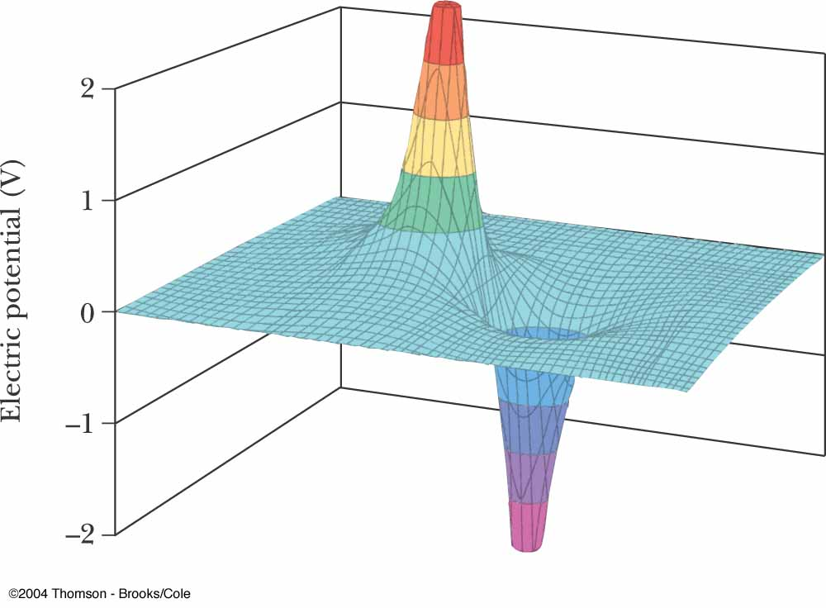
Potential of Multiple Point Charges
The electric potential due to several point charges is the sum of the potentials due to each individual charge
This is another example of the superposition principle
The sum is the algebraic sum

Slide 21
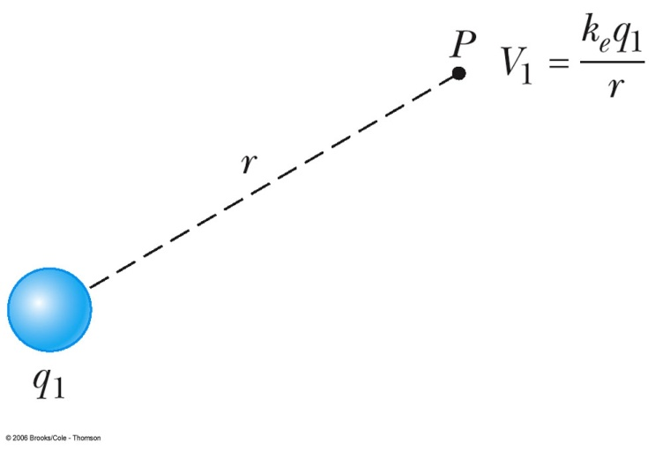
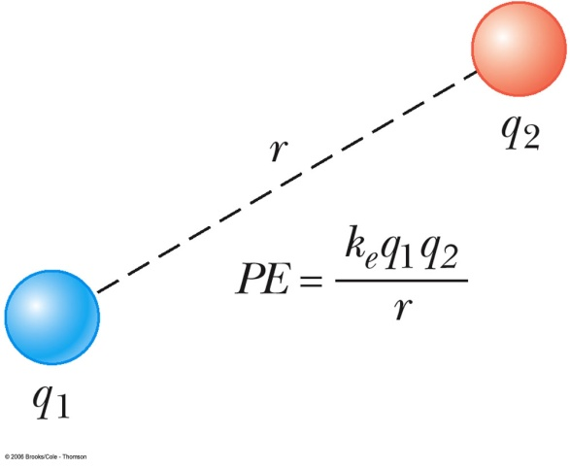
Potential Energy of Multiple Point Charges
V₁: the electric potential due to q₁ at P
The work required to bring q₂ from infinity to P without acceleration is q₂V₁ and it is equal to the potential energy of the two particle system

Slide 22
Potential Energy of Multiple Point Charges
If the charges have the same sign, PE is positive (positive work must be done to force the two charges near one another), so the charges would repel
If the charges have opposite signs, PE is negative (work must be done to hold back the unlike charges from accelerating as they are brought close together), so the force would be attractive

Slide 23
Finding E From V
Assuming that the field has only an x component
Similar statements would apply to the y and z components
Equipotential surfaces must always be perpendicular to the electric field lines passing through them

Slide 24
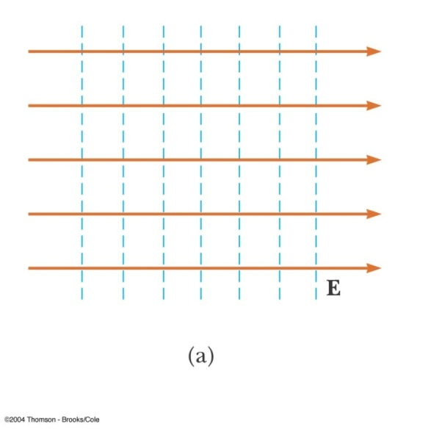
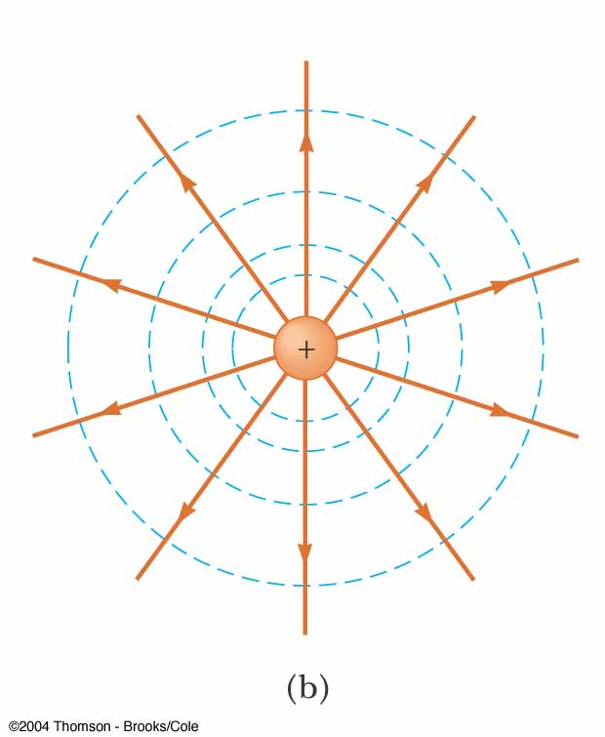
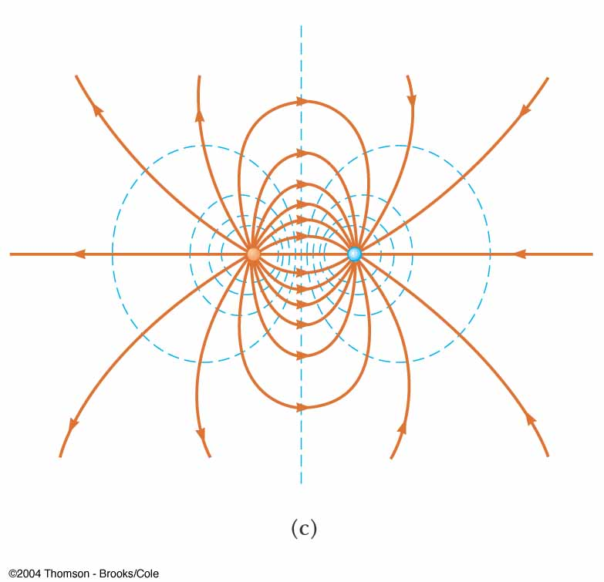
Equipotential Surfaces
For a uniform electric field the equipotential surfaces are everywhere perpendicular to the field lines
For a point charge the equipotential surfaces are a family of spheres centered on the point charge
For a dipole the equipotential surfaces are are shown in blue

Slide 25
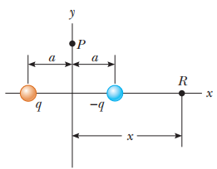

Problem: 25.4
An electric dipole consists of two charges of equal magnitude and opposite sign separated by a distance 2a as shown in Figure. The dipole is along the x axis and is centered at the origin.
(A) Calculate the electric potential at point P on the y axis.

Slide 26

Problem: 25.4
An electric dipole consists of two charges of equal magnitude and opposite sign separated by a distance 2a as shown in Figure. The dipole is along the x axis and is centered at the origin.
(B) Calculate the electric potential at point R on the +x axis.

Slide 27



Problem: 25.4
An electric dipole consists of two charges of equal magnitude and opposite sign separated by a distance 2a as shown in Figure. The dipole is along the x axis and is centered at the origin.
(C) Calculate V and E_{x} at a point on the x axis far from the dipole.

Slide 28
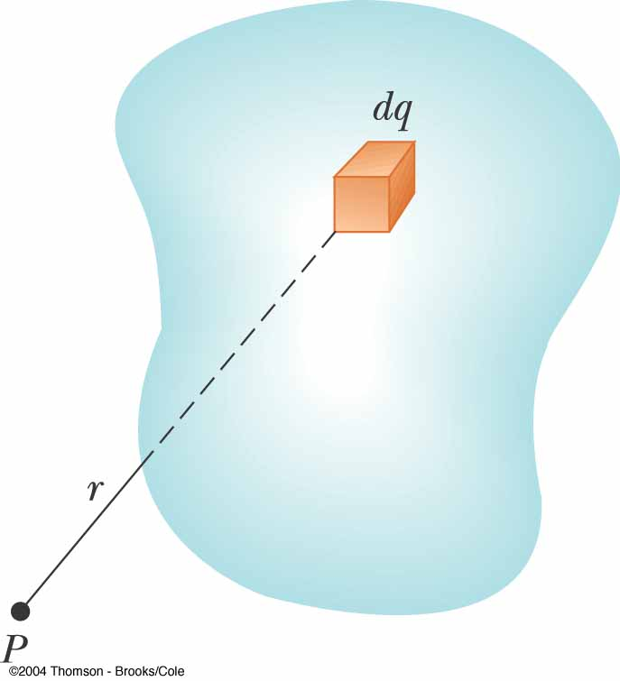
Potential for a Continuous Charge Distribution
Consider a small charge element dq
Treat it as a point charge
The potential at some point due to this charge element is
To find the total potential: integration including contributions from all the elements
This value for V uses the reference of V = 0 when P is infinitely far away from the charge distributions

Slide 29
V From a Known E
If the electric field is already known from other considerations, the potential can be calculated using the original approach
If the charge distribution has sufficient symmetry, first find the field from Gauss’ Law and then find the potential difference between any two points
Choose V = 0 at some convenient point

Slide 30
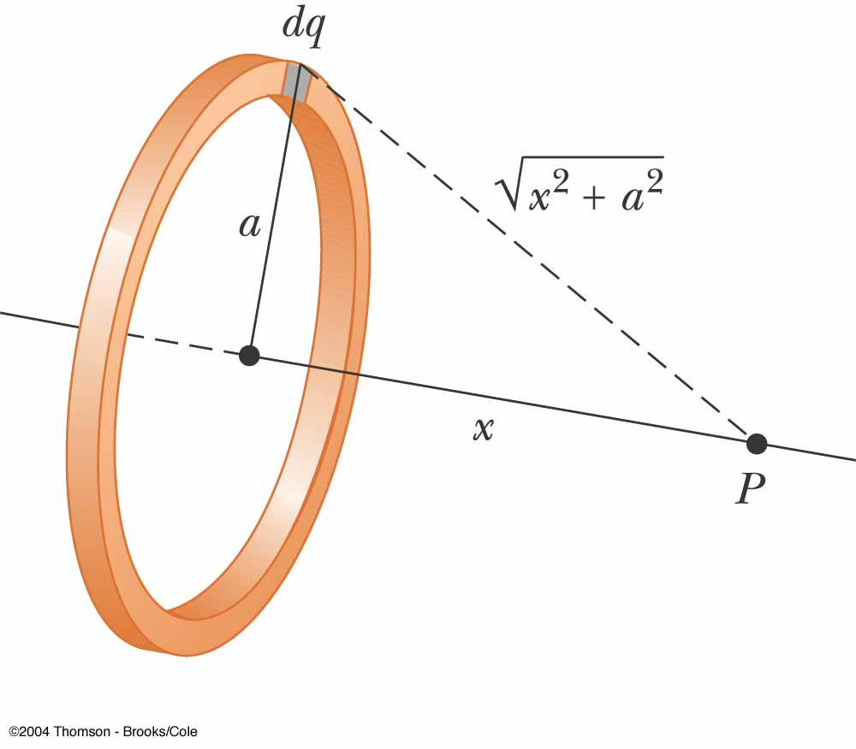
Problem 25.5: Uniformly Charged Ring
(A) Find an expression for the electric potential at a point P located on the perpendicular central axis of a uniformly charged ring of radius a and total charge Q.

Slide 31
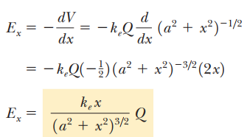
Problem 25.5: Uniformly Charged Ring
(B) Find an expression for the magnitude of the electric field at point P.

Slide 32
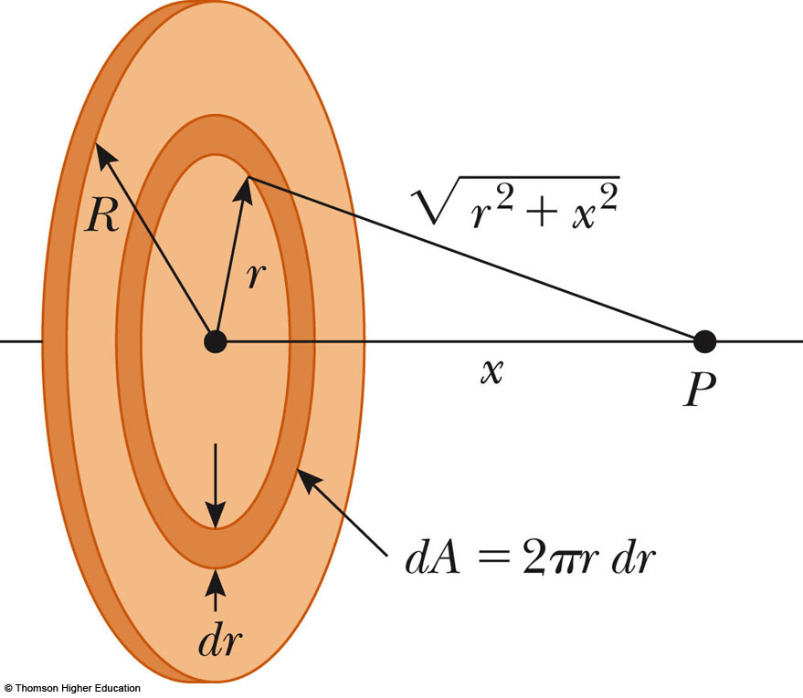
Problem 25.6 : Electric Potential Due to a Uniformly Charged Disk
A uniformly charged disk has radius R and surface charge density σ.
(A) Find the electric potential at a point P along the perpendicular central axis of the disk.

Slide 33

Problem 25.6 : Electric Potential Due to a Uniformly Charged Disk
(B) Find the x component of the electric field at a point P along the perpendicular central axis of the disk.

Slide 34

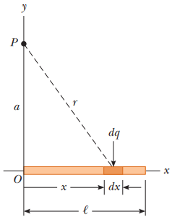




Practice Problem 25.7:

Slide 35
Practice Problem
In an X-ray tube, a uniform electric field of 300 KN/C extends over a distance of 10 cm, from an electron source to a target; the field points from the target to the source. Find the potential difference between source and target and the energy gained by an electron as it accelerates from source to target (where its abrupt deceleration produces X rays). Express the energy in both electronvolts and joules.

Slide 36
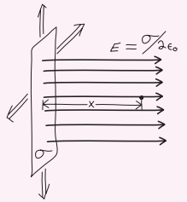
Practice Problem:
An isolated, infinite charged sheet carries uniform surface charge density . Find an expression for the potential difference from the sheet to a point a perpendicular distance x from the sheet.

Slide 37
Practice Problem
A charge +Q lies at the origin and -3Q at x = a. Find two points on the x-axis where V = 0.

Slide 38
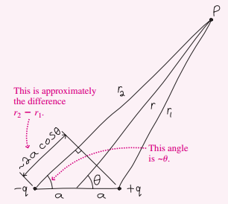
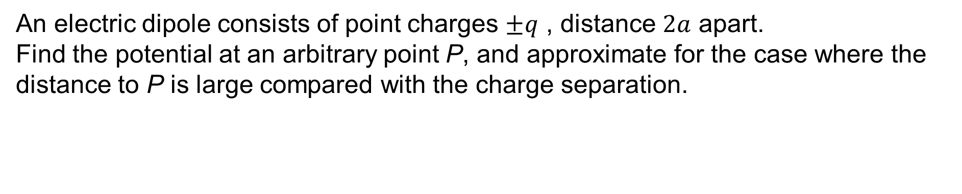
Practice Problem:
An electric dipole consists of point charges $±q$ , distance $2a$ apart.
Find the potential at an arbitrary point P, and approximate for the case where the distance to P is large compared with the charge separation.

Slide 39
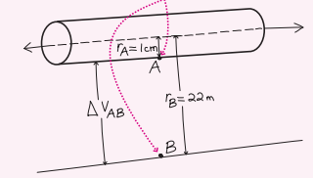
Practice Problem:
A long, straight power-line wire has radius 1.0 cm and carries line charge density , Assuming no other charges are present, what’s the potential difference between the wire and the ground, 22 m below?

Slide 40
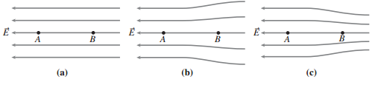
Practice Problem:
The figure shows three straight paths AB of the same length, each in a different electric field. The field at A is the same in each. Rank the potential differences in increasing order.

Slide 41
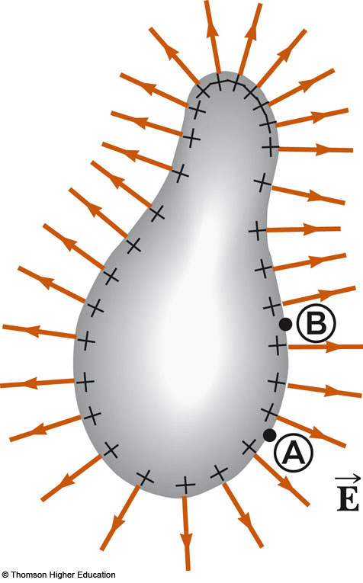
Potentials and Charged Conductors
Electric field is always perpendicular to the displacement ds, thus
Therefore, the potential difference between A and B is also zero
V is constant everywhere on the surface of a charged conductor in equilibrium
ΔV = 0 between any two points on the surface

Slide 42
Potentials and Charged Conductors
The surface of any charged conductor in electrostatic equilibrium is an equipotential surface
The charge density is high (low) where the radius of curvature is small (large)
The electric field is large near the convex points (small radii of curvature)
Because E = 0 inside the conductor, the electric potential is constant everywhere inside the conductor and equal to the value at the surface

Slide 43
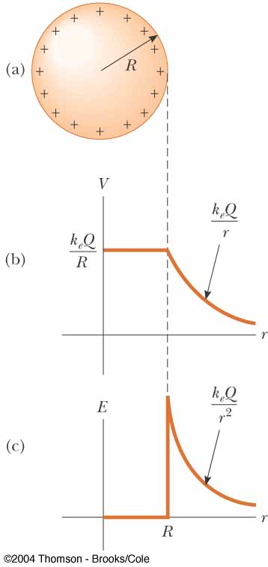
Potentials and Charged Conductors
The charge sets up a vector electric field which is related to the force
The charge sets up a scalar potential which is related to the energy
The electric potential is a function of r
The electric field is a function of r²

Slide 44
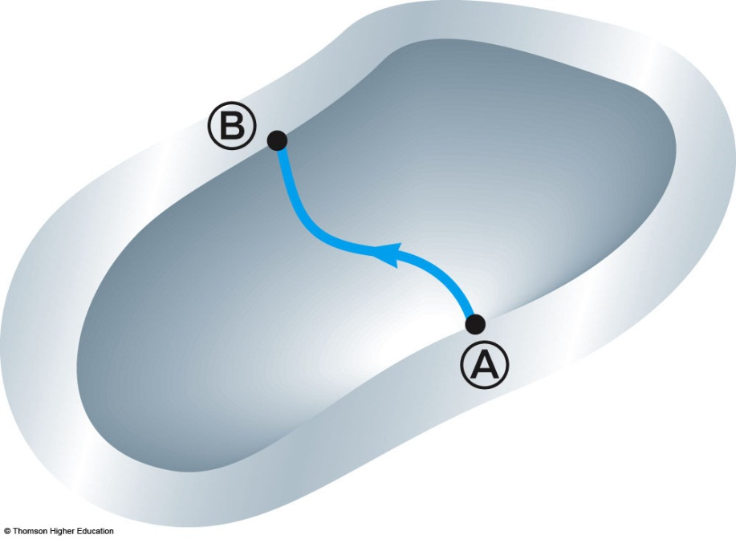
Cavity in a Conductor
With no charges inside the cavity, the electric field inside the conductor must be zero
The electric field inside does not depend on the charge distribution on the outside surface of the conductor
For all paths between A and B,
Thus, a cavity surrounded by conducting walls is a field-free region as long as no charges are inside the cavity

Slide 45
Practice Problem
A sphere of radius R carries negative charge of magnitude Q, distributed in a spherically symmetric way. Find the escape speed for a proton at the sphere’s surface that is, the speed that would enable the proton to escape to arbitrarily large distances starting at the sphere’s surface.

Slide 46


